Slide 1
NAME: NAVKIRAN KAUR
PROGRAM: BTECH (IT)
ROLL NO.: 2221080

Slide 2
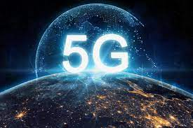
TOPIC:- 5th GENERATION TECHNOLOGY

Slide 3
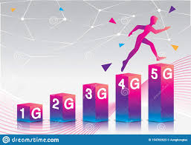

EVOLUTION

Slide 4
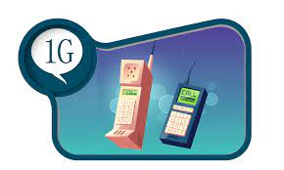
ANALOG-BASED PROTOCOLS
BASIC VOICE SERVICE
POOR BATTERY LIFE
POOR VOICE QUALITY:- DROPPED CALLS
SPEED
2.4 kbps
YEAR
1979

Slide 5

VOICE CALLS AND TEXT ENCRYPTION
DESIGNED FOR VOICE
DATA SERVICES LIKE SMS, PICTURES AND MMS
IMPROVED COVERAGE AND CAPACITY
GSM, CDMA
SPEED
64KBPS
YEAR
1991

Slide 6
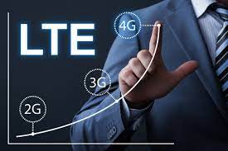

Slide 7
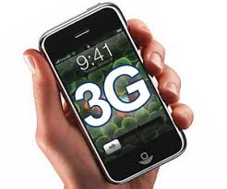
FIRST MOBILE BROADBAND
MORE DATA
VIDEO CALLING+ MOBILE INTERNET ACCESS
SPEED
2000KBPS
YEAR
1998

Slide 8

IP BASED PROTOCOLS
TRUE MOBILE BROADBAND
HIGH SPEED
SPEED
100,000KBPS
YEAR
2008

Slide 9

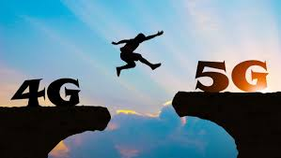

Slide 10
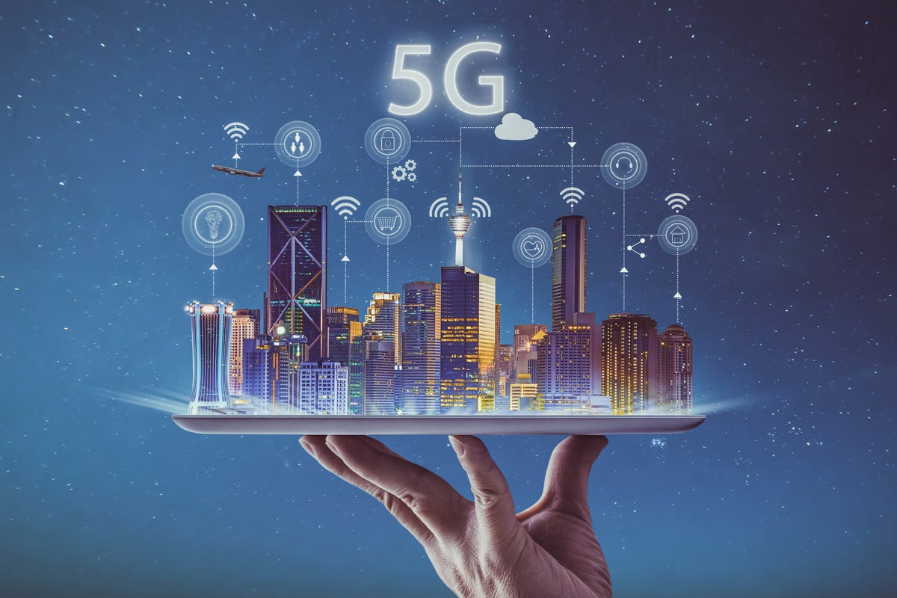

Slide 11
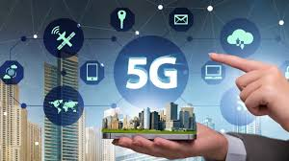
INCREASED DOWNLOADING
LARGE FREQUENCY SPECTRUM
ULTRA LOW-LATENCY
HIGH SPEED AND STABLE CONNECTION
SPEED
1 GBPS
YEAR
2019

Slide 12
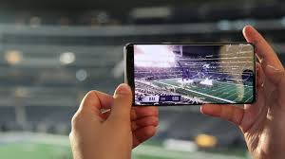
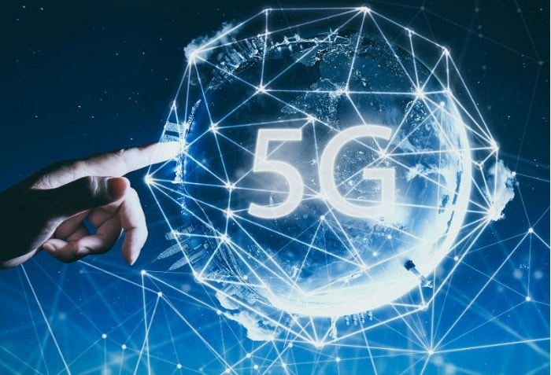

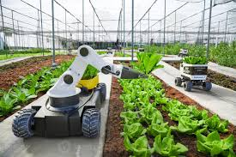

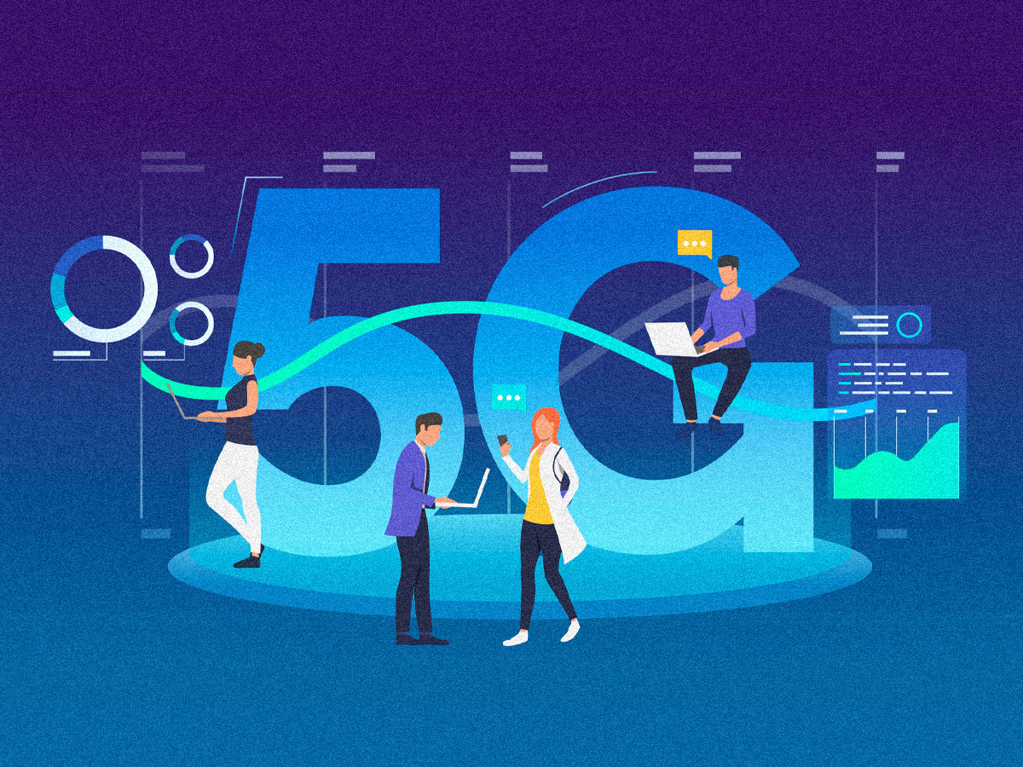
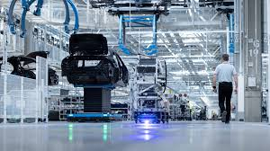
Entertainment and Multimedia
IOT, AI, Cloud Computing
High Speed Mobile Network
Smart Cities, Smart Farming
ADVANTAGES
OF 5G
Telemedicine, Tele
education, etc.
More Jobs In Digital Economy
Industrial Applications

Slide 13
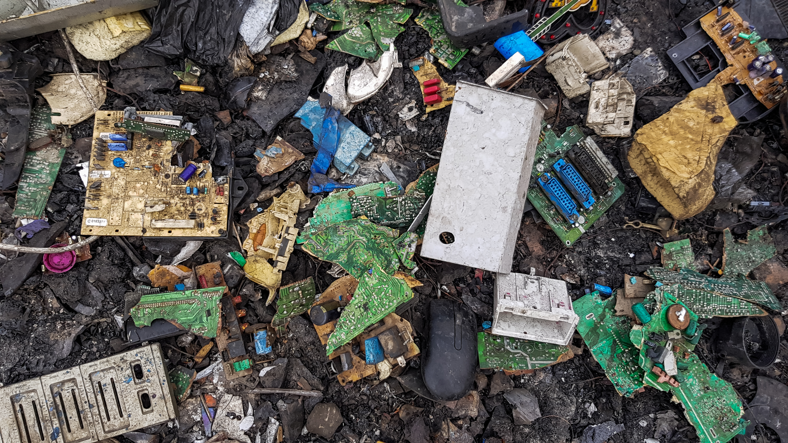

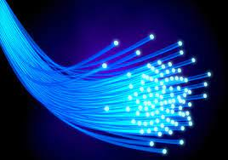



C
H
A
L
L
A
N
G
E
S
E-Waste Generation
Infrastructure
Optical Fibers
Privacy Concern
Data Protection Issues
Telecom Firms Are Financially Stressed

Slide 14

thankyou

